Slide 1
Course Description
Fundamentals of internet programming/Web development

Slide 2
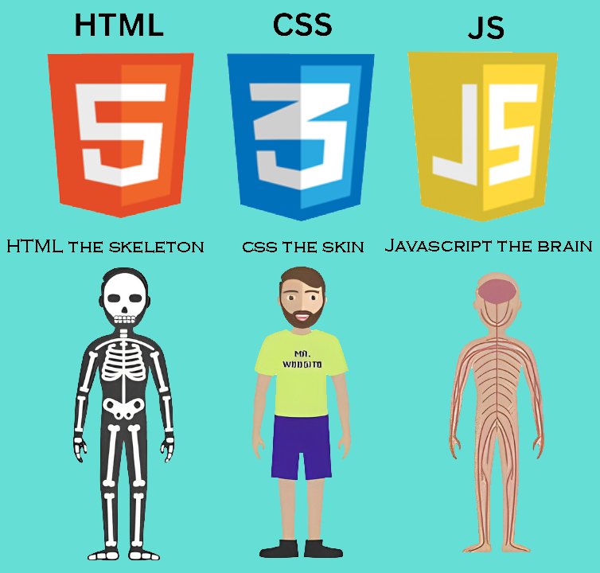
Content
Introduction to basic terminology
Introduction to Hyper Text Markup Language (HTML)
Introduction to Cascading Style Sheet (CSS)
Introduction to JavaScript Scripting language

Slide 3
Course delivery Modalities!
Theory Section
brief description of the topic to be discussed .
Practical Section
Practical Hands on practice on the topic.

Slide 4
Lets Get Start!

